Slide 1
CRIME RATE IN SAN FRANCISCO
Made by : Muhammad OZAIR

Slide 2
INTRODUCTION
People want to move to San Francisco for a better living, but the important factor that must be looked upon is 'Security'. This project analyzes the safe areas in the city where we will explore the crime rate in the city to solve the problem. The audience that will be benefitted are:
Tourists
The business community for the investment
People looking for a better living
People looking for Relocation

Slide 3
DATA
Crime dataset in San Francisco:
https://cocl.us/sanfran_crime_dataset
Map of San Francisco:
https://cocl.us/sanfran_geojson.
Data is having following column list:
IncidntNum, Category, Descript, DayOfWeek, Date, Time, PdDistrict, Resolution, Address, X, Y, Location, PdId, Neighborhood, Ranking

Slide 4
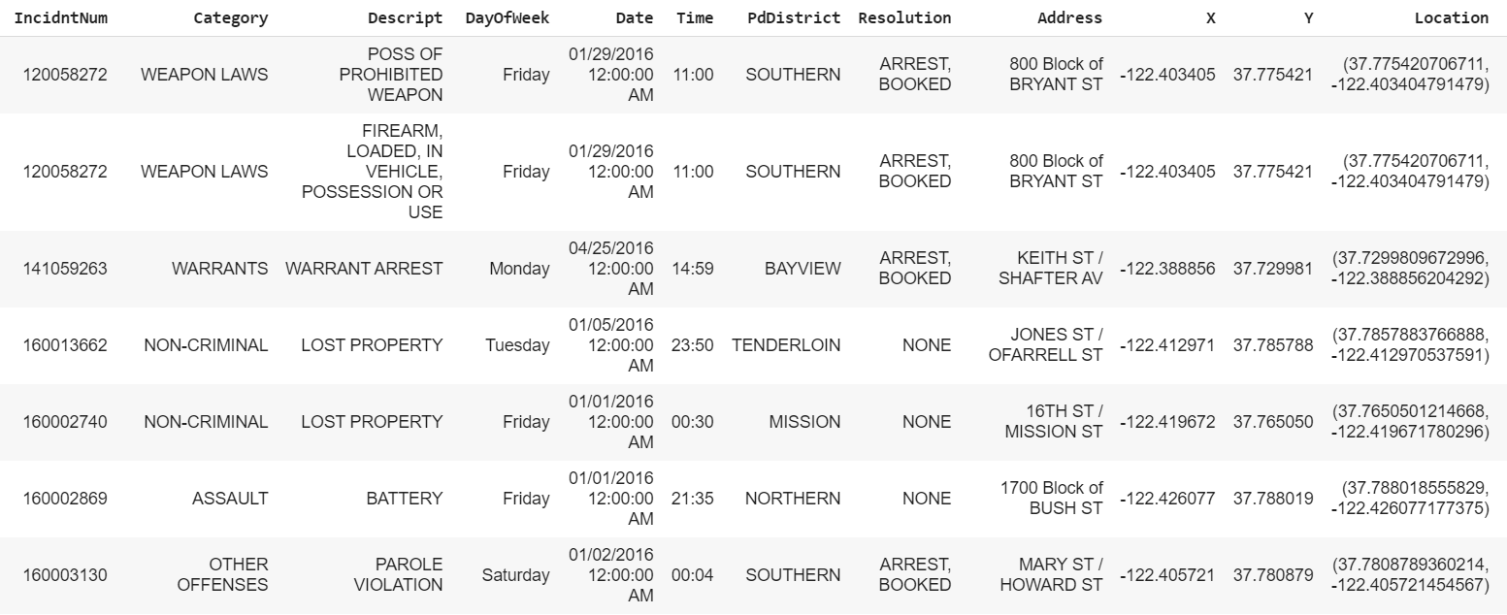
DATA Presentation

Slide 5
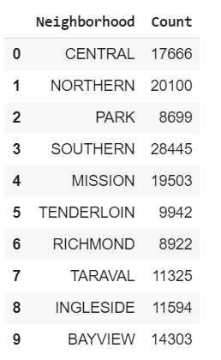
METHODOLOGY
The Neighborhoods are; Central, Northern, Park, Southern, Mission, Tenderloin, Richmond, Taraval, Ingleside, Bayview
Methodology was simple to analyze the total number of crimes in the neighborhoods and establish the output on the map.
The number shows the high and the low crime rates and the safe areas are well versed the data-frame.

Slide 6
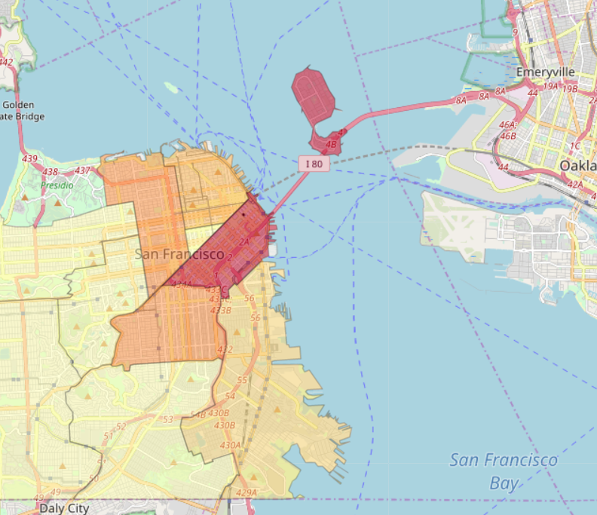
RESULTS
The table in the Methodology section shows the crime rate.
The highlighted areas show the areas where highly crimes exist.

Slide 7
CONCLUSION
The map clearly shows the highly affected areas with the low crime rate areas of the city. The highest affected section is the SOUTHERN part having the highest rate of crime and the lowest are the PARK as the Methodology data frame shows.
The people can now move towards the city after reviewing the areas where they can live easily with their family. The businessmen can now review for their investment purpose, the burger joint is likely to invest in the area that is not higher in crime rate and like the remaining sections of the society will decide according to their needs.
The recommended areas after watching the map closely are the following:
RICHMOND
TENDERLOIN
Whereas, the not recommended areas are already pointed out as per visualization.

Slide 8
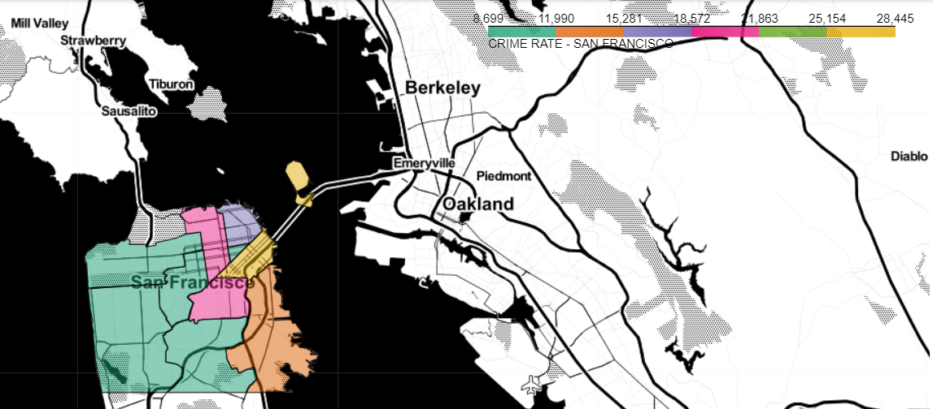
Thank you
THANK YOU

